Slide 1
Chemical Agent Laws
Penal Code
Business and Professions Code
Food and Agriculture Code
Education Code
Welfare and Institution Code

Slide 2
PENAL CODE
Section numbers changed on 1-1-12

Slide 3
17240 PC - Definition
Liquid, Solid or Gaseous Substance
Intended to produce
Temporary discomfort or permanent Injury
Through being vaporized or otherwise released through the air

Slide 4
United Nations
Chemical Weapons Convention
Any chemicals that:
"can produce rapidly in humans sensory irritation or disabling physical effects which disappear within a short time following termination of exposure."
Notes:
Chemical Weapons Convention of the United Nations

Slide 5
17250 PC - Tear Gas Weapon
Shell, cartridge, bomb capable of being exploded
When it is intended to release tear gas
Revolver, pistol, fountain pen gun, Billy
Intended to release tear gas

Slide 6
22900 PC - Possession
Any person, firm or corporation
Knowingly sells, offers for sale, possesses transports
Guilty of a misdemeanor

Slide 7
22820 PC - Peace Officer Exception
A peace officer
Can use carry, etc...
Successfully completes POST instruction in use of tear gas

Slide 8
22830 PC - Military Exception
Military, federal law enforcement
Can purchase, possess, transport
For Official Use in the discharge of their duties

Slide 9
122835 PC - Security Guard Exception
License as a private security guard or private investigator
Purchase, possess, transport
Used solely for defensive purposes
Complete a Dept. Consumer Affairs certified course

Slide 10
22810 PC - Citizen Exception
Persons prohibited from possessing

Slide 11
22810 PC - Citizen Exception
  Addicted to any narcotic drug
  Convicted of a crime involving assault
  Convicted of a felony
  Shall not furnish to a Minor
  Convicted of the misuse of Tear Gas
  No minor (under 16)

Slide 12
22810 PC - Citizen Exception
Used for Self Defense Purposes Only

Slide 13
22810 PC - Citizen Exception
No device that expels projectile
No method other than aerosol
No more than 2.5 ounces of aerosol spray

Slide 14
22810 PC - Citizen Exception
Must have warning label
Expiration date
Printed instruction for use
Ramifications of improper use

Slide 15
22810 PC - Citizen Exception
Use of tear gas
Other than Self Defense
Felony

Slide 16
What is Self Defense?

Slide 17
22815 PC Minors
16 years of age
consent of parent or guardian
Civil liability belongs to person signed consent

Slide 18
22825 PC Jails
Custodial Officer of County
May carry Tear Gas while on-duty
May carry off-duty only in accordance with other laws

Slide 19
830.5 PC
Probation Officers are Peace Officers:
While engaged in the performance of the duties of their respective employment and for the purpose of carrying out the primary function of their employment

Slide 20
22905 PC - Markings
Each device must have
Name of Manufacturer
Expiration Date

Slide 21
22910 (a) PC - Destruction of Markings
Changes, alters, removes, obliterates
Serial number or mark of identification
Felony
Possession presumptive

Slide 22
171b PC - Possess in Public Building
Possess in public building
Meeting required to be open to public
Unauthorized Tear Gas Weapon
Wobbler

Slide 23
171b PC - Possess in Public Building
Exception Peace Officer
Official duties
Shall apply if party to action

Slide 24
4502 PC - Poss. Weapon
Confined to prison or road camp
Possess carries
Tear gas
Felony

Slide 25
Food and Agriculture Code

Slide 26
12753 F&A Economic Poison
Any substance
Repelling Pests

Slide 27
12995 F&A - Possession
Possess or use
Economic Poison
Not Registered
Misdemeanor

Slide 28
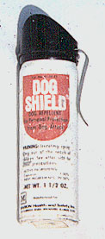

Slide 29
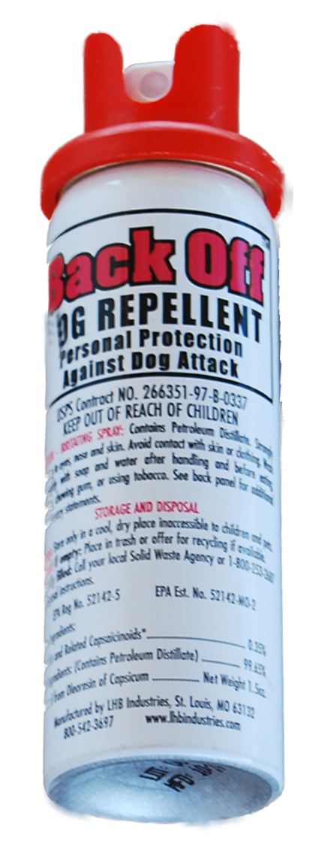

Slide 30

HALT II DOG REPELLENT
(7754- 38-AA )
HALT! DOG REPELLENT
(7754- 37-AA )

Slide 31
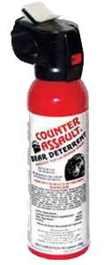
COUNTER ASSAULT BEAR DETERRENT ( 55541- 2-AA )

Slide 32
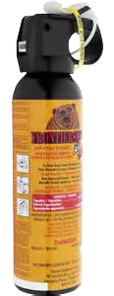
FRONTIERSMAN BEAR ATTACK DETERRENT
( 72265- 1-AA )

Slide 33
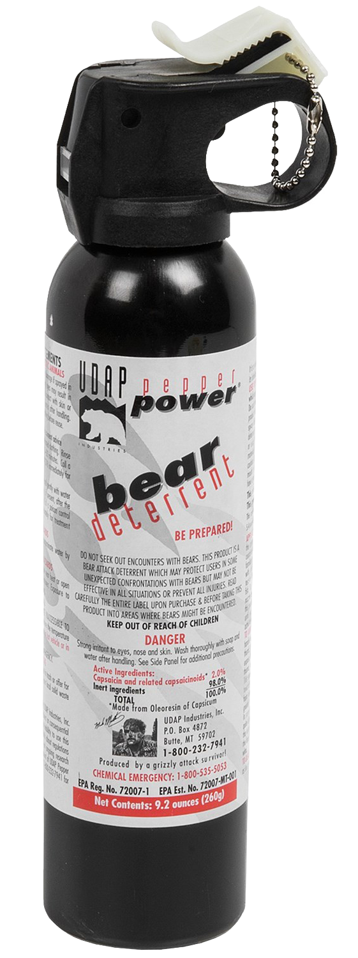
UDAP PEPPER POWER BEAR DETERRENT
( 72007- 1-AA )

Slide 34
EDUCATION CODE

Slide 35
49330 EdC - Injurious Objects
Any object listed in 17240 PC
Not necessary for Academic purposes of the pupil

Slide 36
49331 EdC - Removal from Poss.
Designated Certified Employee
May Remove Injurous Object
From personal possession of student
Upon school property or under authority of school

Slide 37
49332 EdC - Notification of Parent
Parent or guardian
Maybe notified
Of taking

Slide 38
49333 EdC - Return of Object
Pupil presents object
May have object returned
Conclusion of school
If legal to possess off grounds

Slide 39
Welfare and Institutions Code

Slide 40
871.5 W&I - Juvenile Hall
Knowingly brings or sends into, assists or uses
Juvenile Hall, Camp, etc
Any weapon including Tear Gas
Felony

Slide 41
Code of Federal Regulations

Slide 42
Federal Aviation Regulation

Slide 43
Moral Aspects of Using
"Tear Gas"

Slide 44
Have a thorough knowledge of tear gas and/or tear gas weapons and their effects so they can be prudently utilized by you.

Slide 45
Use only that force
which is reasonable.

Slide 46
Maintain order, but never attempt to punish.

Slide 47
Both Private and Public property must be respected at all times.

Slide 48
Every reasonable effort a diffusing a situation should be considered before dispensing chemical agents.

Slide 49
Use in a progressive escalation of weaponry

Slide 50
Do not use to quell verbal attacks.

Slide 51
Never use on an already controlled prisoner.

Slide 52

www.CAinstructor.com
www.TearGasResource.com

Slide 53
FISHER v.
CITY OF SAN JOSE

Slide 54
WHAT IS THIS CASE ABOUT?
Steven Fisher claims constitutional violations stemming from a twelve-hour standoff at his apartment between him and a large number of San Jose police officers, at the end of which he came out of the apartment and submitted to arrest.

Slide 55
THE FACTS
Fisher sued the city of San Jose and several officers under 42 U.S.C. & 1983, contending, among other things, that the arrest was invalid because the police never obtained or attempted to obtain a warrant. A jury found for the defendants (the City) on all claims, including a claim for warrantless arrest. Fisher thereupon filed a renewed motion under Federal Rule of Civil Procedure 50 for judgment as a matter of law on the warrantless arrest claim.

Slide 56
MORE FACTS
Granting the motion against the City alone, the 4th District Court ordered the City to pay nominal damages of one dollar and issued an injunction regarding future training of police officers. We uphold the district court’s ruling on appeal, as we agree that the failure to obtain a warrant under the unusual circumstances of this case constituted a constitutional violation as a matter of law.

Slide 57
MAIN POINTS OF FISHER
Passage of time during a standoff will exhaust exigency at some point, leading to an opportunity to obtain a warrant safely.
Introducing chemical agents into a residence is an intrusion.
Without a warrant any intrusion is a violation of 4th Amendment.

Slide 58
UNITED STATES COURT OF APPEALS
FOR THE NINTH CIRCUIT
The jurors in this case determined that exigent circumstances justified the initial arrest and reached an eminently reasonable conclusion that the San Jose Police Department should be commended for handling this dangerous situation properly and ultimately bringing about a peaceful resolution.
For these reasons, I would reverse the district court’s grant of Fisher’s renewed motion for judgment as a matter of law and reinstate the Jury’s verdict.

